Slide 1


Credit Card Clustering for Market Segmentation
Group 3
Hasaranga Jayathilake
Mansi Sudhirbhai Joshi
Sri Naga Venkata Vijay Kumar Pulavarthi
Srilekha Nampelli

Slide 2
Contents
Introduction
Data Exploration
Data Cleaning and Manipulation
Exploratory Data Analysis
Feature Selection and Dimensionality Reduction
Clustering Analysis
Overview
Visualization
Analysis
Conclusion
References

Slide 3
Introduction
Understanding Credit Card User Behavior
Segmentation for Targeted MarketinG
Clustering Techniques for Analysis

Slide 4
Dataset Exploration
The dataset contains 9000 active credit card holders' behavior over 6 months
It includes 18 behavioral variables such as balance, purchases, cash advances, and payment frequency
Investigated the distribution and summary statistics of each variable

Slide 5
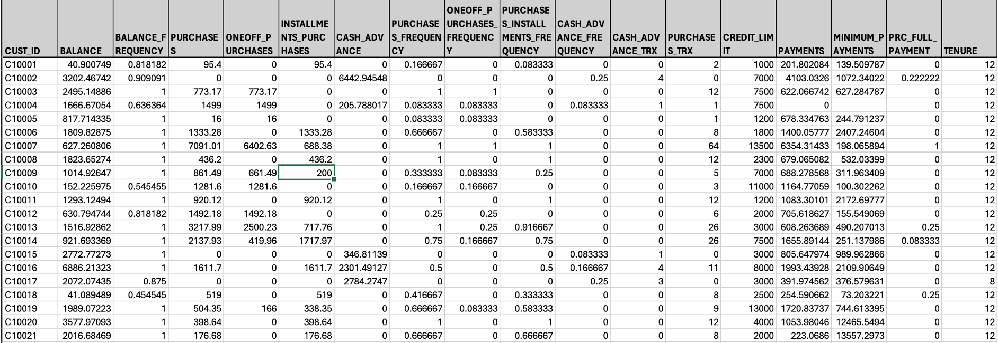
Dataset

Slide 6
Data Cleaning and Manipulation
Original Variable Names Displayed
Transformation of Variable Names
Missing Values Removal
Updated Dataset Size
Notes:
Original Variable Names Displayed:
Initially, the original variable names, which were in all capital letters, were displayed to provide insight into the dataset structure.
Transformation of Variable Names:
The variable names were transformed into a more reader-friendly form using the str_to_title function.
This step aimed to enhance readability and comprehension of the dataset.
Missing Values Removal:
Missing values were removed from the dataset using the na.omit() function.
This ensured that only complete cases were retained for subsequent analysis.
Updated Dataset Size:
After removing missing values, the number of rows in the dataset was updated to reflect the reduction in size.
The updated dataset now contains a total of 8636 rows.

Slide 7
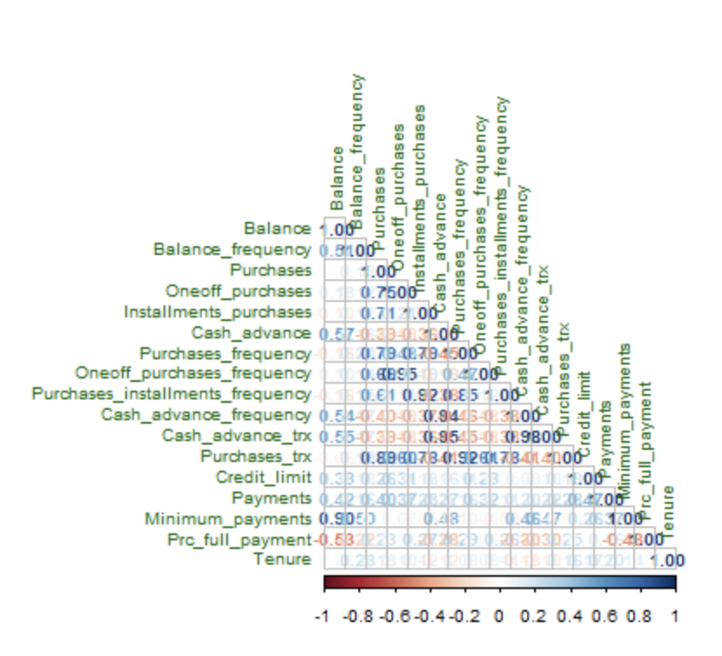
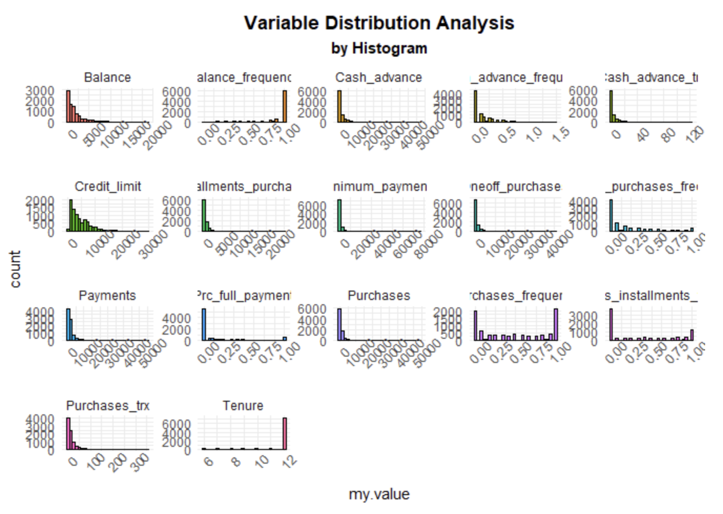
Exploratory Data Analysis (EDA):

Slide 8
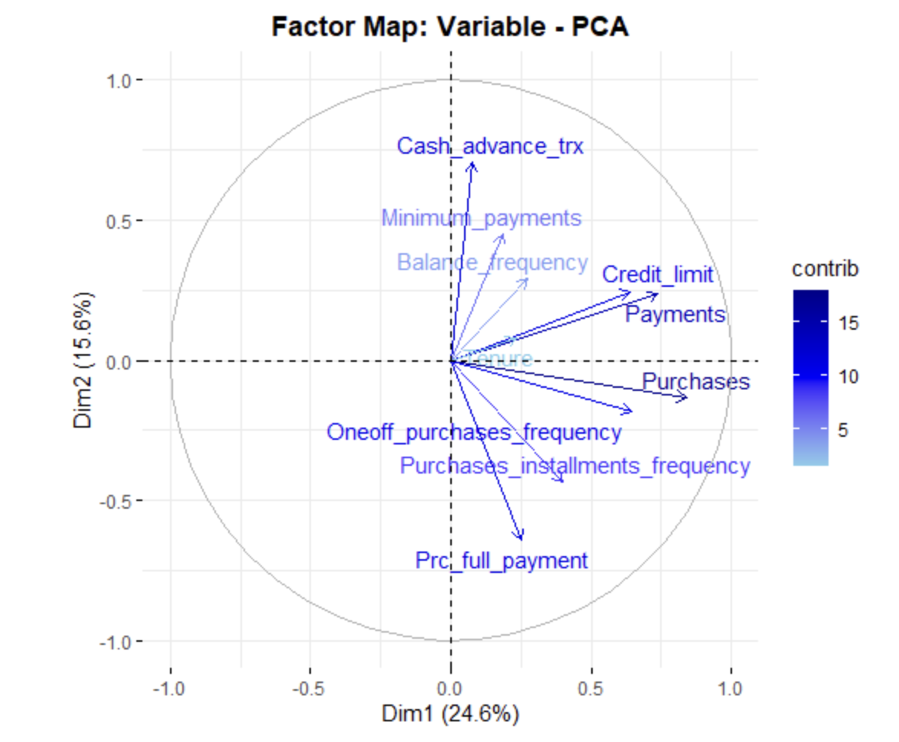
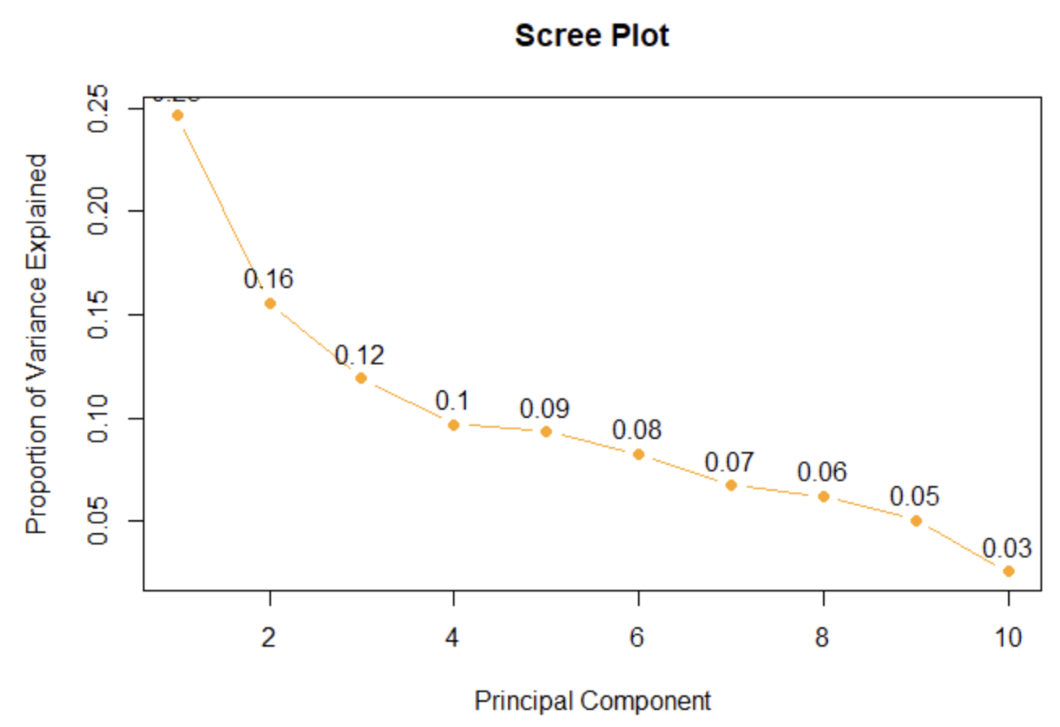
Feature Selection and Dimensionality Reduction
Standardization of Data
Principal Component Analysis (PCA)
Identification of Important Variables

Slide 9
Cluster Analysis
CLARA (Clustering Large Applications)
Hierarchical K-Means Clustering
Fuzzy Clustering
Model-Based Clustering
DBSCAN (Density-Based Spatial Clustering for Applications with Noise
Cluster Tendency Assessment

Slide 10
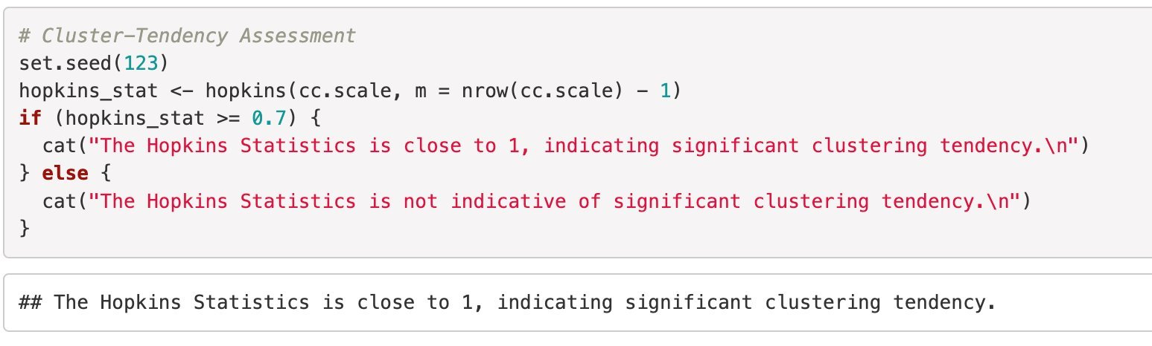
Cluster Tendency Assessment
Utilizing the Hopkins Statistics method, we evaluate the spatial randomness of the data to assess the tendency for clustering.
The analysis yields a Hopkins statistic close to 1, indicating significant clustering tendencies in the credit card dataset across various implementations of the statistic.

Slide 11
CLARA (Clustering Large Applications)
Utilized CLARA due to its efficiency and adaptability to large datasets.
01
Employing sampling techniques to reduce computational and memory constraints in clustering analysis.
02
Scalability and Suitability: CLARA's ability to handle large datasets while maintaining computational efficiency.
03
Notes:
Usage of CLARA:
Given the dataset's size, CLARA (Clustering Large Applications) is chosen as the clustering algorithm. CLARA is an extension of PAM (Partitioning Around Medoids) specifically designed for large datasets. It employs a sampling approach to overcome computational and memory constraints. CLARA is preferred over hierarchical clustering methods due to its scalability.

Slide 12
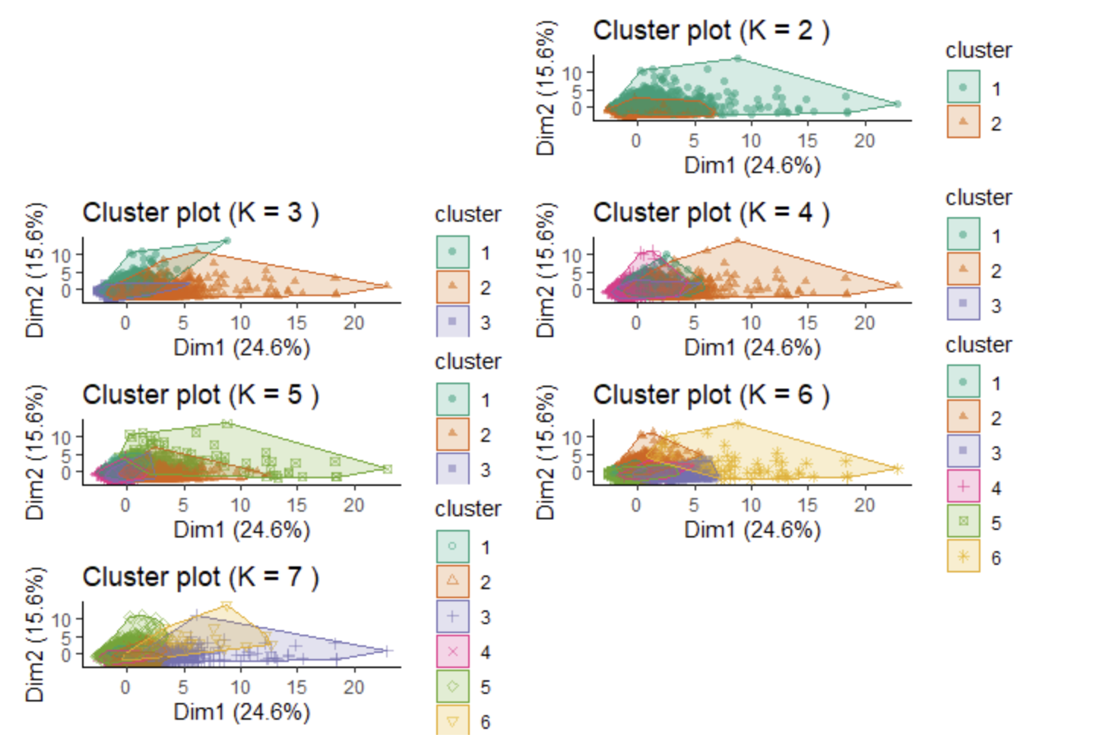
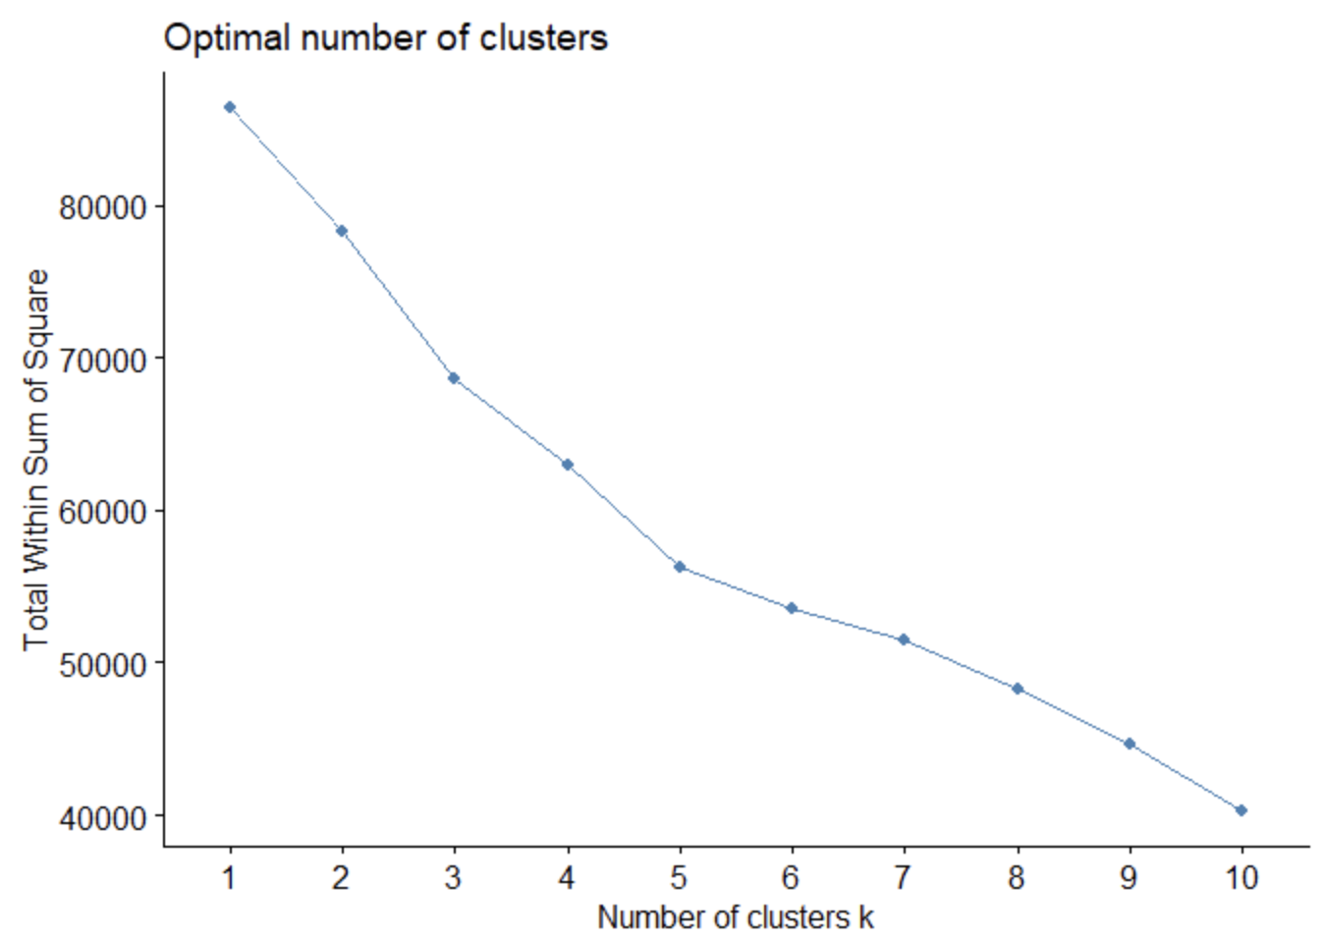
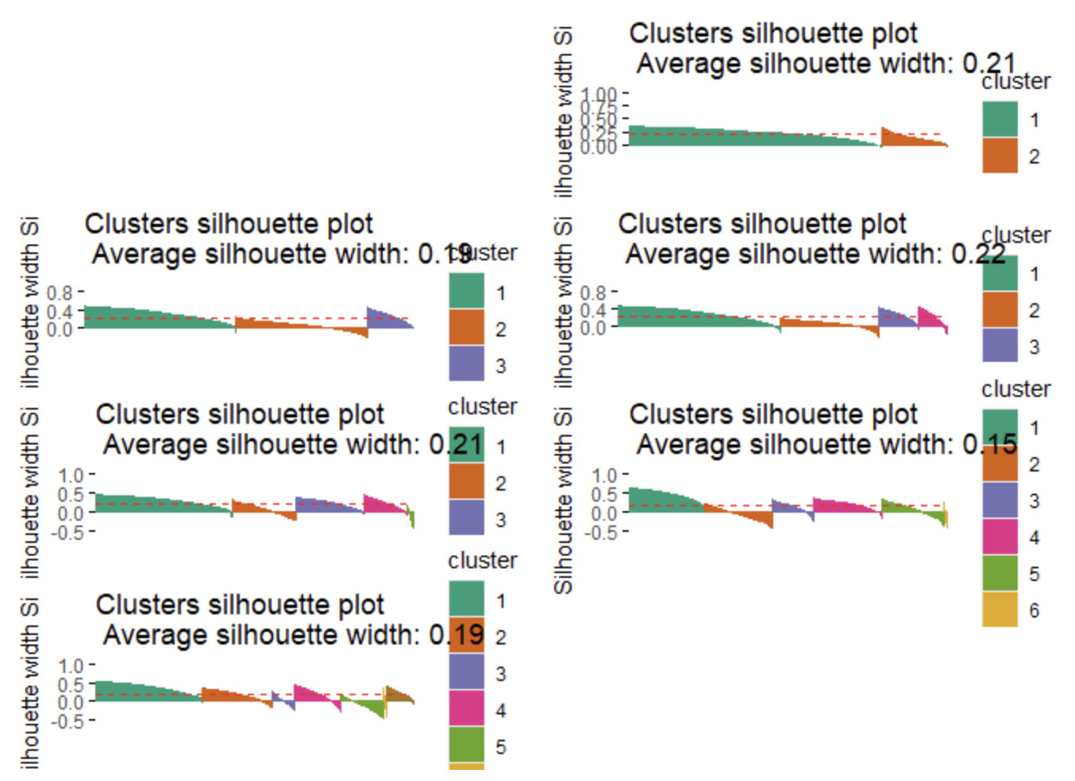
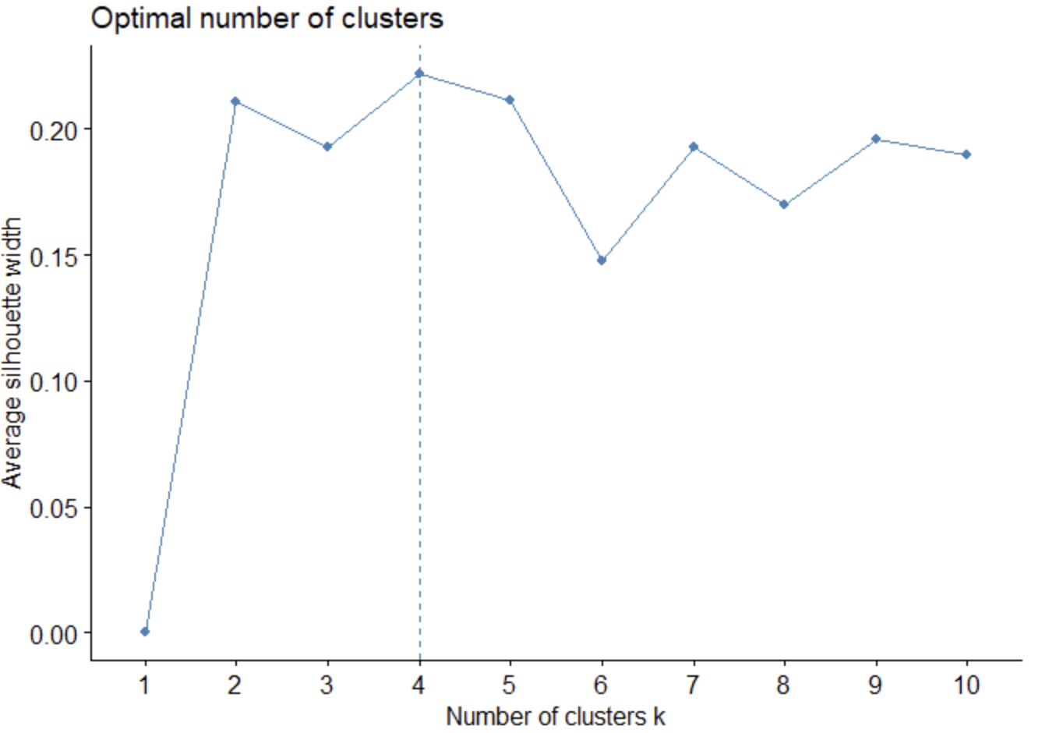
Visualization
Notes:
Visualizations:
Six CLARA Algorithms: We run six CLARA algorithms with varying cluster numbers (K) to explore different partitionings of the data. Visualizing these partitions helps us understand how the clusters evolve with different K values.
Elbow Method: The Elbow Method is utilized to determine the optimal number of clusters (k). By calculating the Total Within Sum of Squares (WSS) for different k values, we identify a bend or "elbow" where the reduction in WSS slows down significantly, suggesting the optimal k. In our analysis, k = 5 or 6 is suggested by the Elbow Method.
Silhouette Method: The Silhouette Method is employed to assess the quality of clustering. It uses the average silhouette width, with higher values indicating better clustering. Our analysis indicates k = 4 as the optimal number of clusters based on the Silhouette Method.

Slide 13
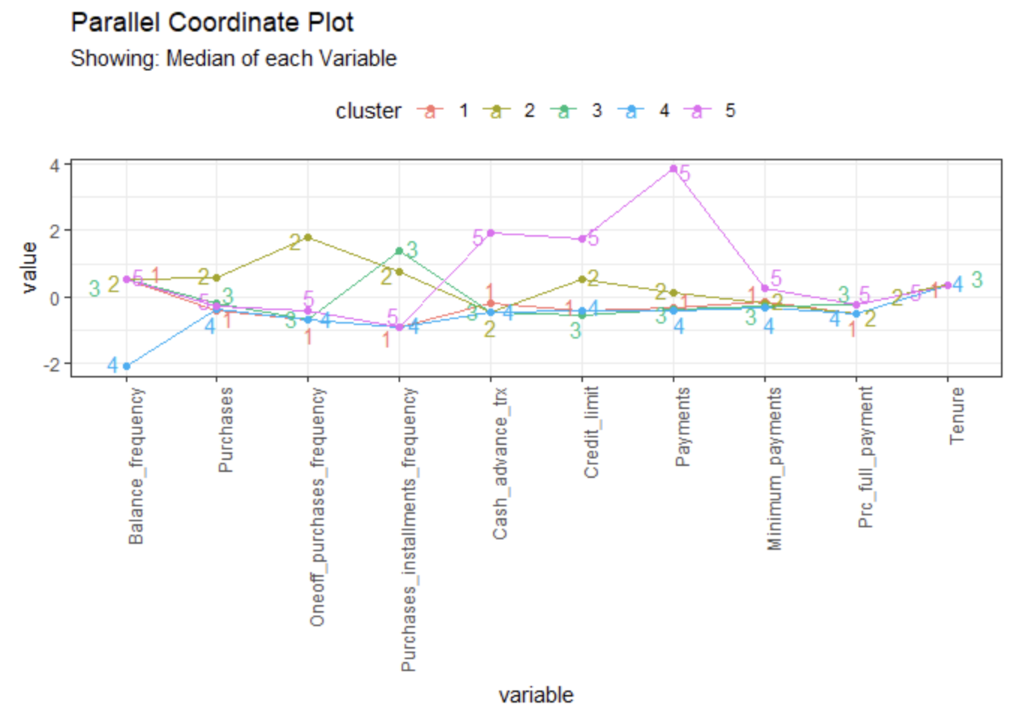
CLARA Clustering Analysis
Optimal Cluster Number Selection
Cluster Identification
Interpretation of Clusters.
Notes:
Analysis:
Optimal Cluster Number Selection: Based on both the Elbow and Silhouette methods, we choose 5 as the optimal number of clusters for CLARA. This decision provides a balance between the two methods.
Cluster Identification: Five distinct groups of credit card users are identified based on their behavior and transaction patterns: Infrequent Users, One-off Purchasers, Installment Purchasers, Max Payers, and Active Revolvers.
Interpretation of Clusters: Each cluster exhibits unique characteristics, such as payment behavior, purchase patterns, and credit card usage frequency. These insights into customer segmentation can inform targeted marketing strategies or product offerings. Additionally, parallel coordinate plots visualize median variable values within each cluster, facilitating deeper interpretation of cluster characteristics.

Slide 14
Hierarchical K-Means Clustering
Combines K-means with hierarchical clustering for enhanced results.
01
Overcomes K-means' initial centroid randomness by using optimized centroids from hierarchical clustering.
02

Slide 15
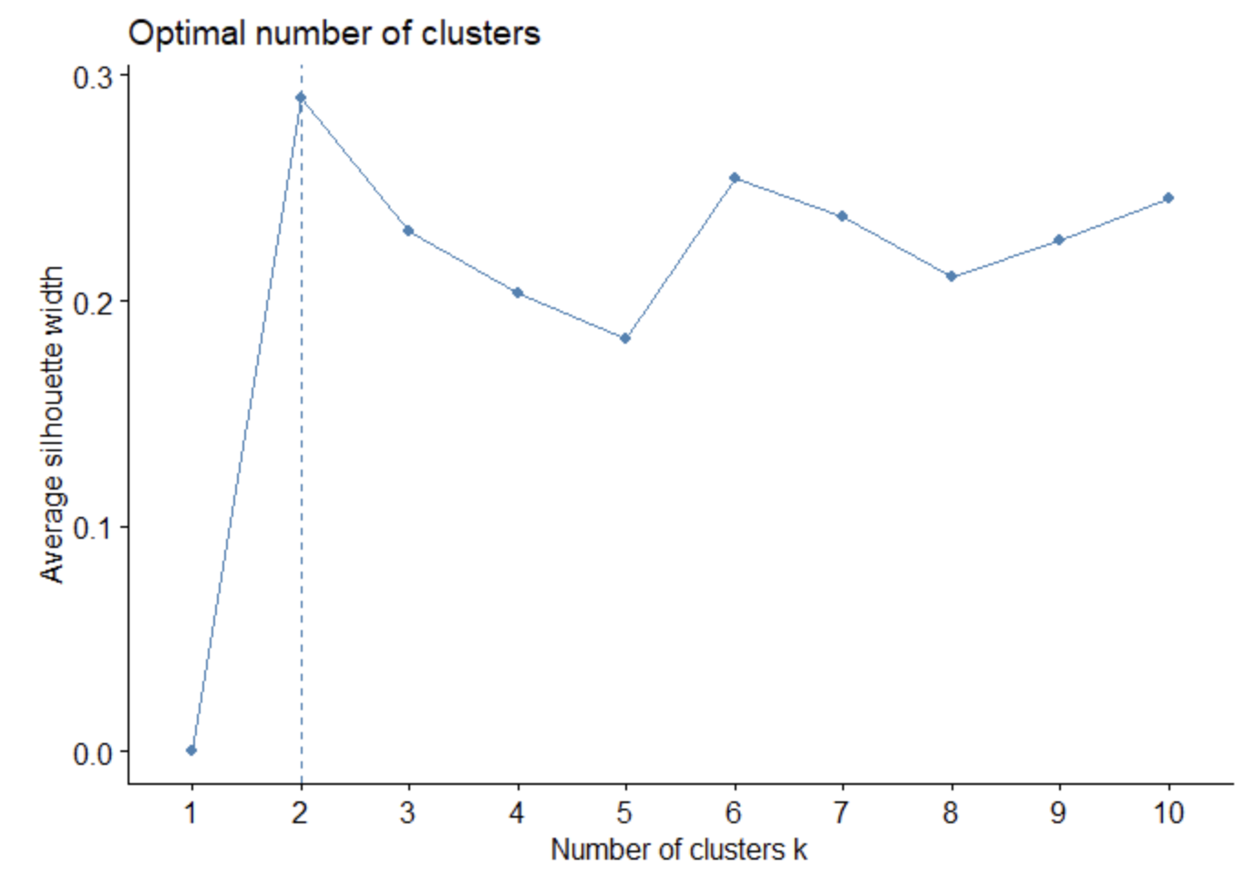
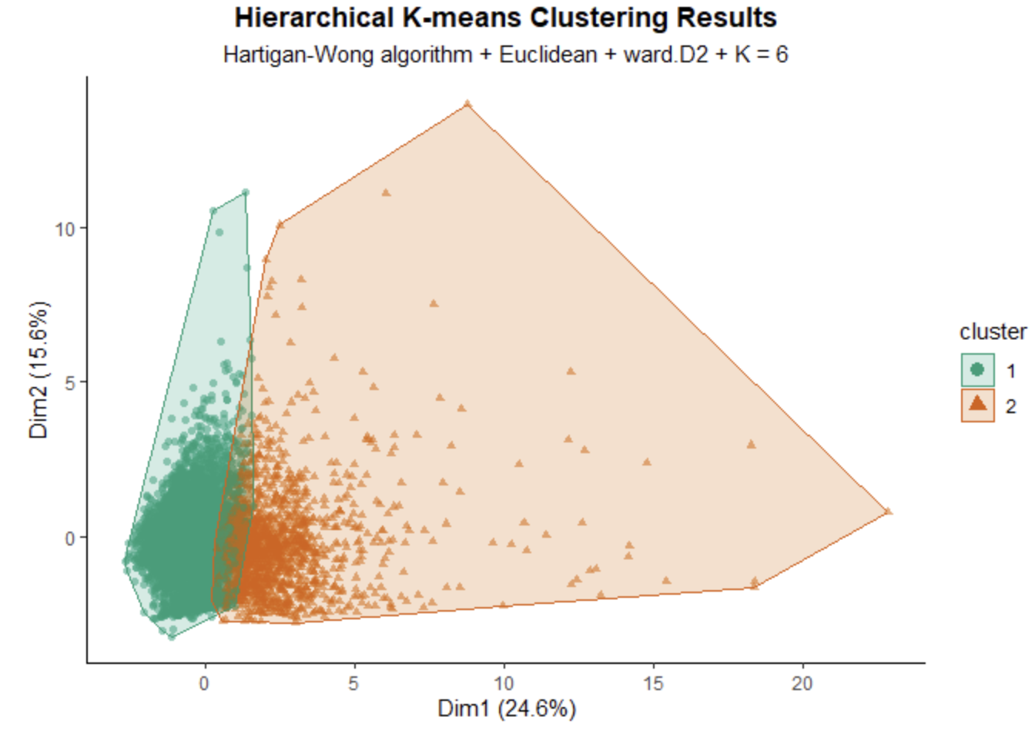
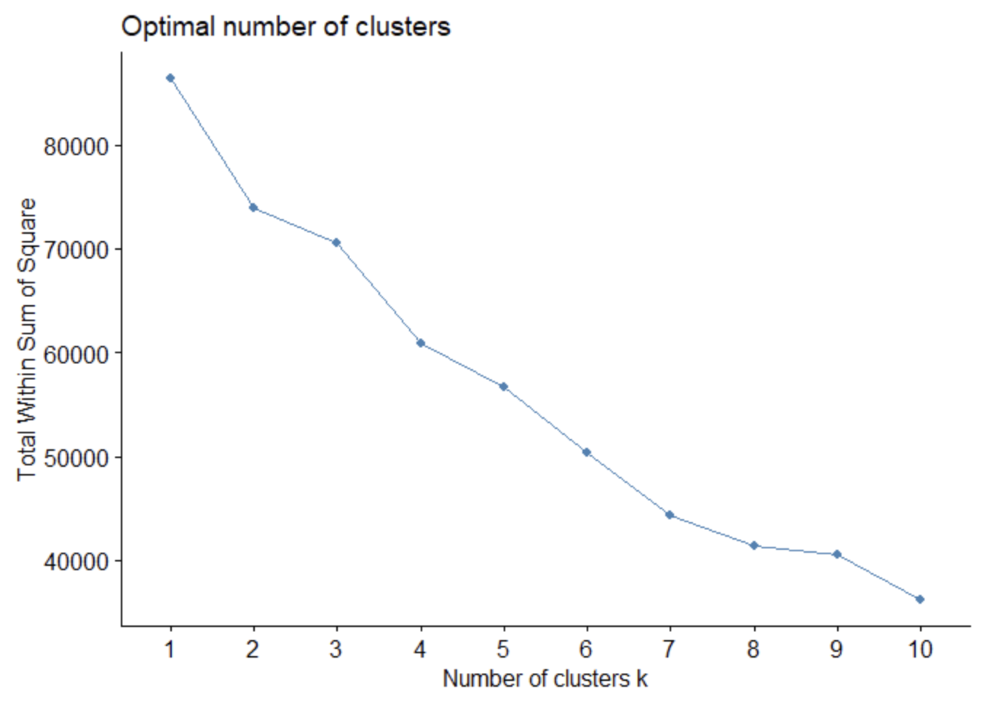
Visualization

Slide 16
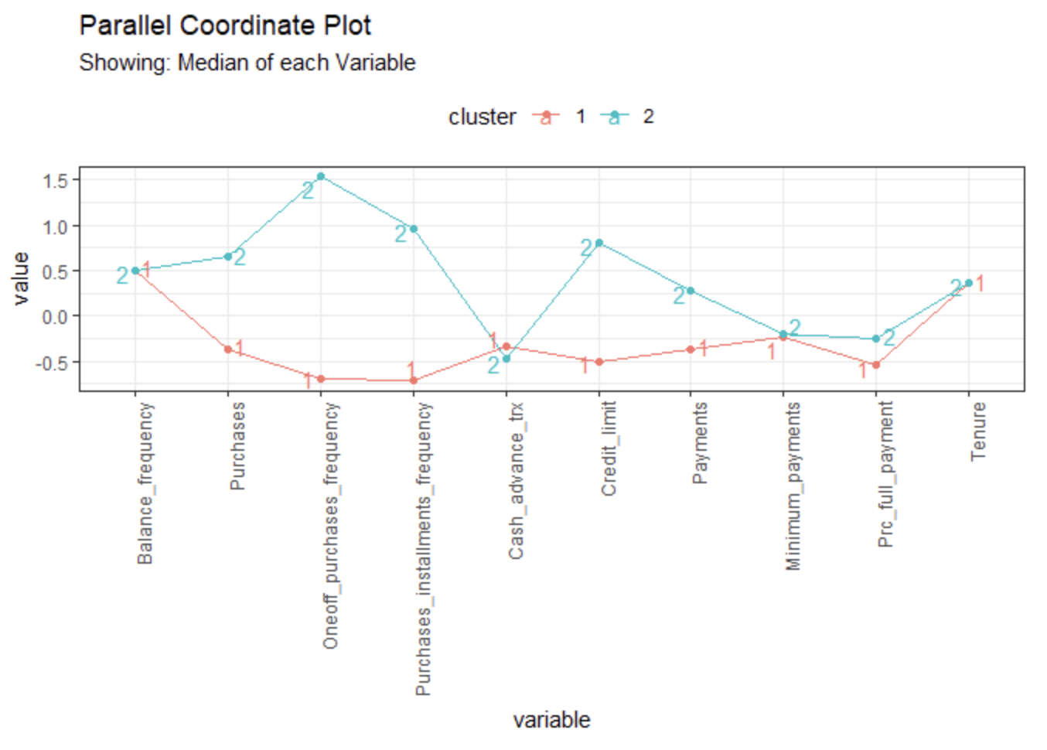
HK - Means Analysis
Identification of Optimal K
Cluster Formation
Notes:
Analysis:
Both the Elbow and Silhouette methods suggest K = 2 as optimal for clustering.
Cluster 1 (Less-active users) rarely use their credit cards, while Cluster 2 (Active users) frequently make purchases, especially one-off purchases.

Slide 17
Fuzzy Clustering
Nuanced Clustering Approach
01
Probability-Based Cluster Assignments
02
Notes:
Usage of Fuzzy Clustering:
Fuzzy clustering provides a nuanced approach to clustering by assigning probabilities of belonging to each cluster rather than strict assignments.
It is particularly useful in marketing analysis scenarios where users may exhibit overlapping behaviors across multiple clusters.

Slide 18
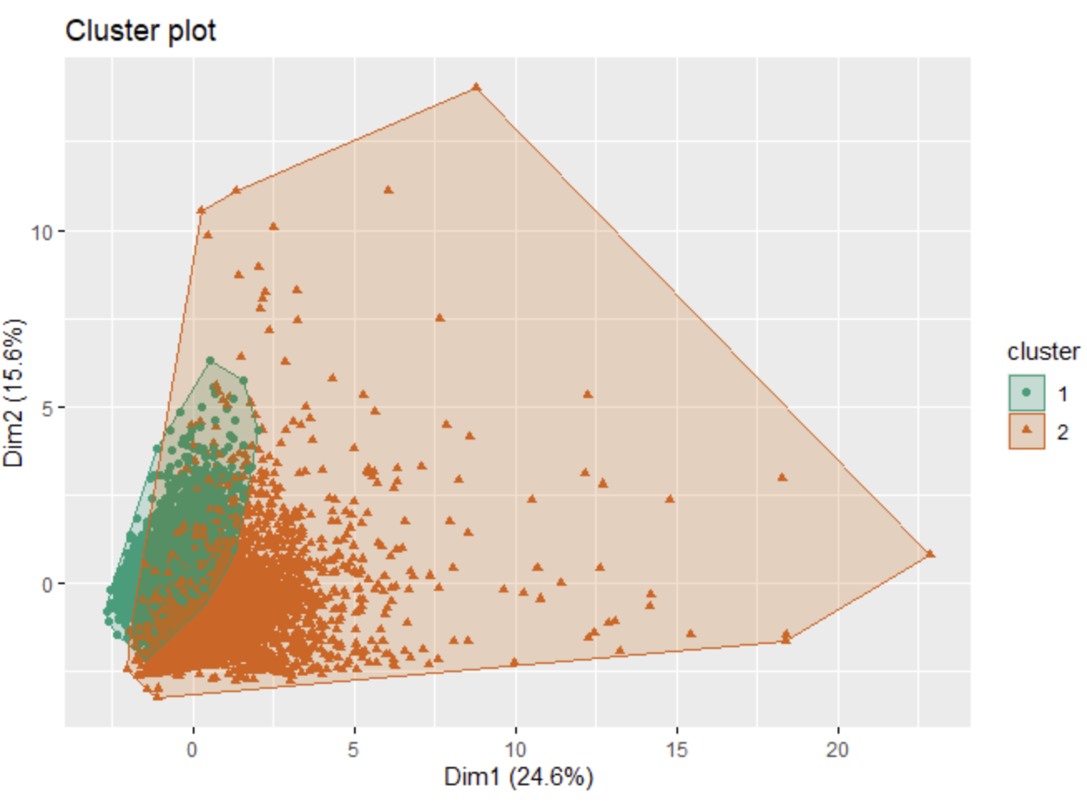
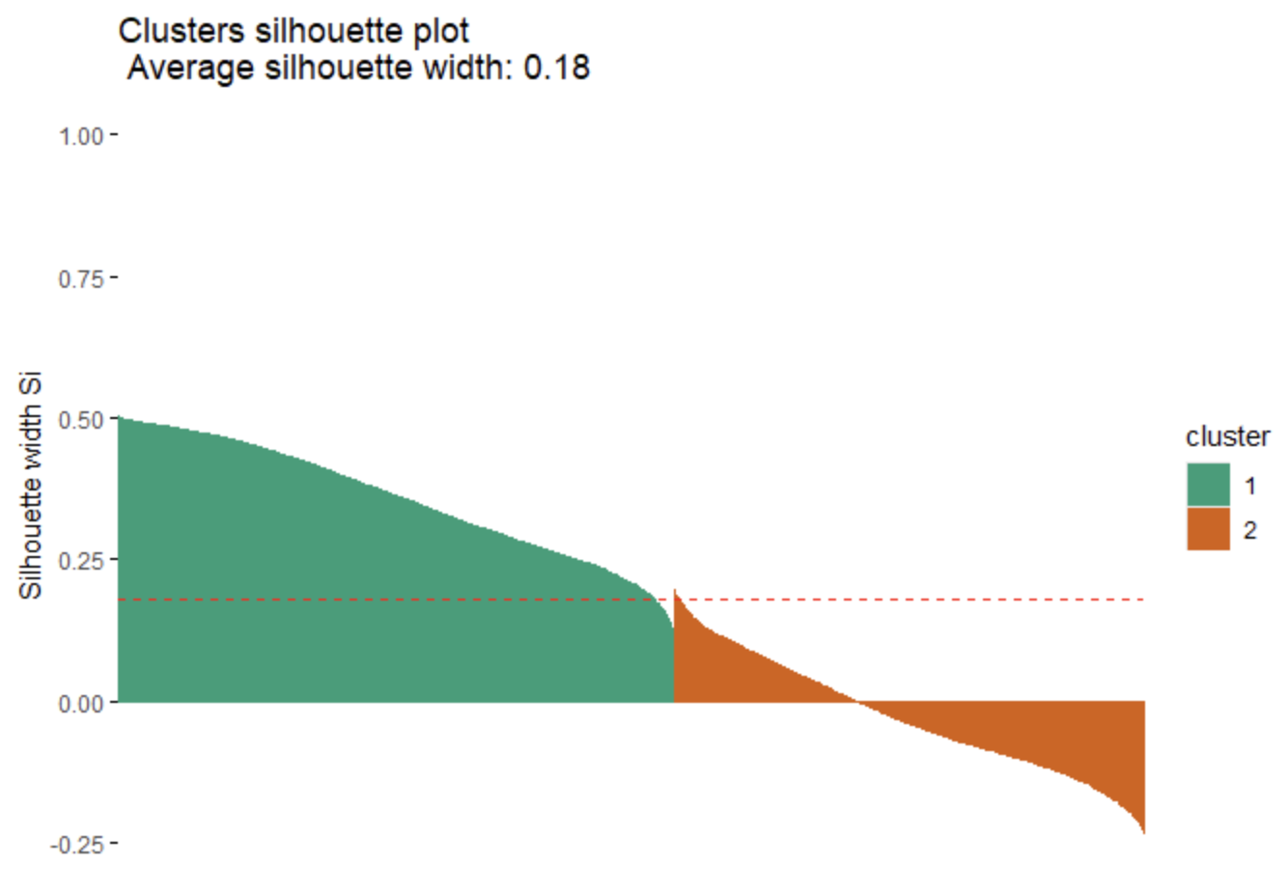
Visualizations
Notes:
Visualizations:
Silhouette Width Explanation:
Silhouette width (Si) assesses clustering quality, with values ranging from 1 to -1.
High Si values indicate well-clustered points, while negative values suggest potential misclassifications.
Silhouette Plot Analysis:
The silhouette plot for Fuzzy clustering shows generally low silhouette levels across all clusters, indicating clustering quality issues.
Presence of noise suggests caution in interpreting results from this plot.

Slide 19
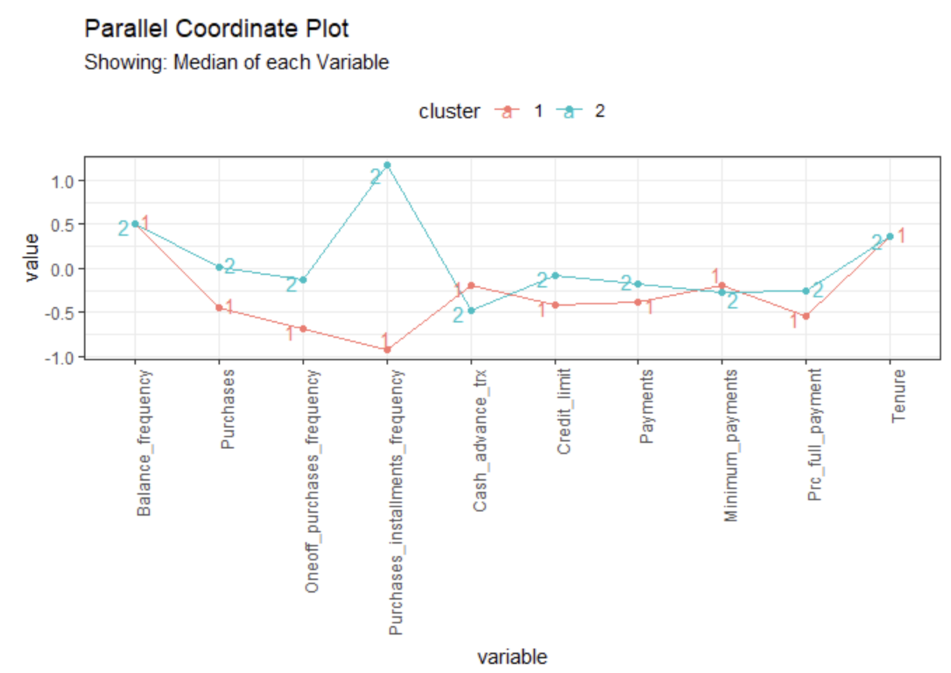
Fuzzy Cluster Analysis
Comparison with Hierarchical K-means
Cluster Insights and Differences
Notes:
Analysis:
Comparison with Hierarchical K-means:
Fuzzy clustering with 2 clusters aligns with Hierarchical K-means, grouping users into less-active and active categories.
Differences include a stronger preference for cash in advance in Cluster 1 and a higher popularity of installment purchases in Cluster 2.
Both methods highlight Cluster 2's tendency towards full repayment over minimum payments, despite differences in cluster composition.

Slide 20
Model-Based Clustering
Model-based Clustering with EM Algorithm:
Expectation-Maximization (EM) Algorithm
Hierarchical Approach
01
Optimal Model Selection with BIC:
Bayesian Information Criterion (BIC)
VEV Model Selection
02
Notes:
Model-based Clustering with EM Algorithm:
Uses Expectation-Maximization (EM) algorithm to identify clusters with varying densities.
Hierarchical approach segments dendrogram into k clusters, defining cluster characteristics.
Optimal Model Selection with BIC:
Bayesian Information Criterion (BIC) guides model selection, favoring higher BIC values.
VEV model selected with 5 clusters, each with distinct volume, equal shape, and varying orientation.

Slide 21
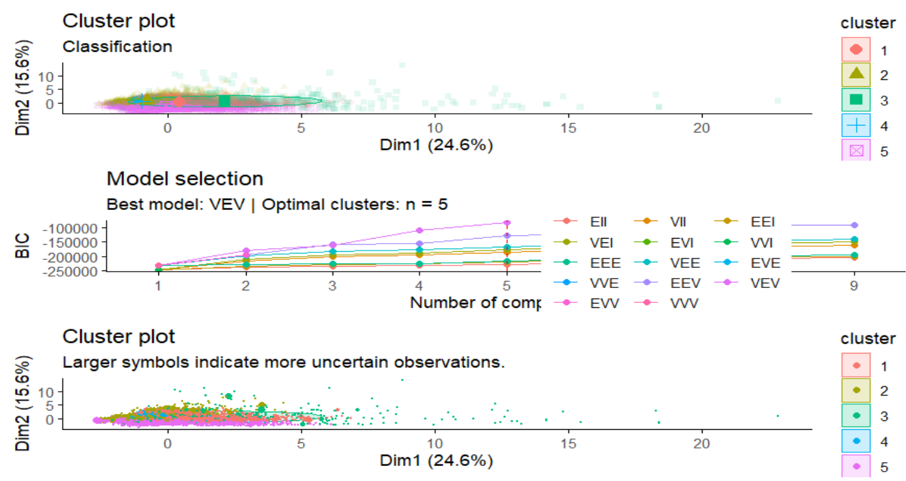
Visualization

Slide 22
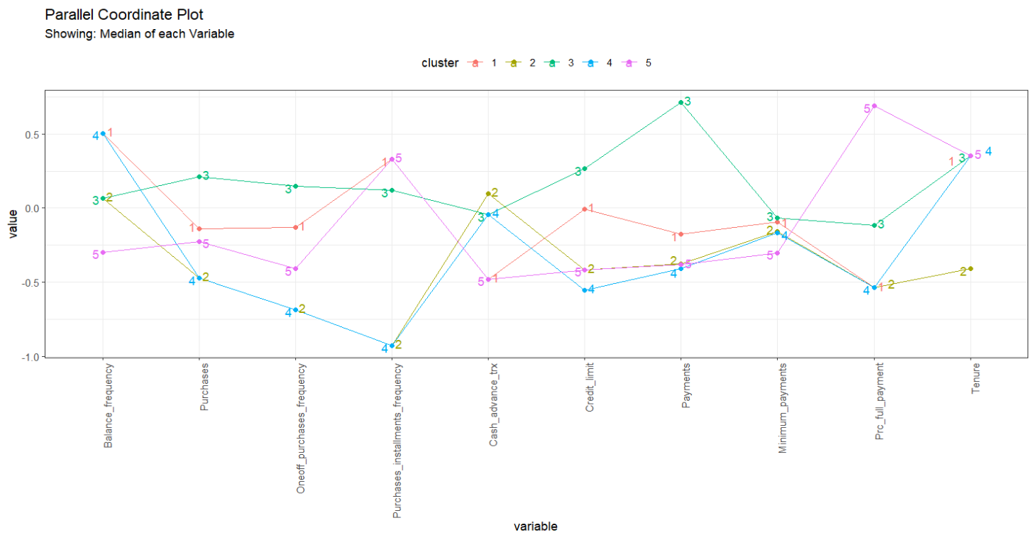
Model Based Cluster Analysis
Cluster characterization
Notes:
Cluster Characterization: Cluster 1: Less active users preferring full payment, comprising 3090 users with low activity and full payments. Cluster 2: Also less active, but with preferences for cash-in-advance or credit card purchases, totaling 1090 users. Cluster 3: Active users making large payments, 484 users with high-value transactions and varied payment habits. Cluster 4: Revolvers preferring minimum payments, 1313 users engaging in costly purchases with minimum payments. Cluster 5: Less active users with slight preference for installment purchases, totaling 2659 users with low activity and preference for installments.

Slide 23
DBSCAN (Density-Based Spatial Clustering for Applications with Noise)
Identification of Outliers and Clusters
01
Parameter Selection: epsilon (eps) and minimum points (MinPts)
02
Notes:
Identification of Outliers and Clusters: DBSCAN is utilized to identify outliers and cluster observations based on their density.
Parameter Selection: Two main parameters, epsilon (eps) and minimum points (MinPts), are chosen based on dataset size and characteristics.

Slide 24
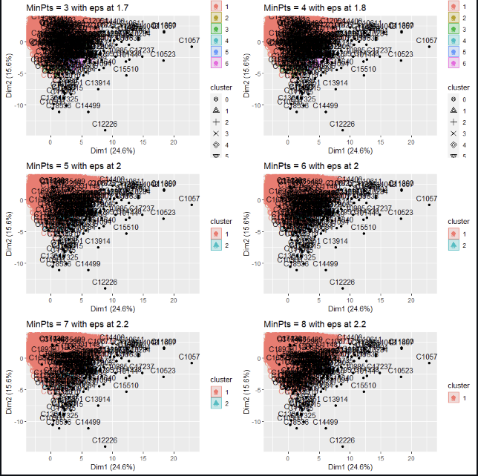
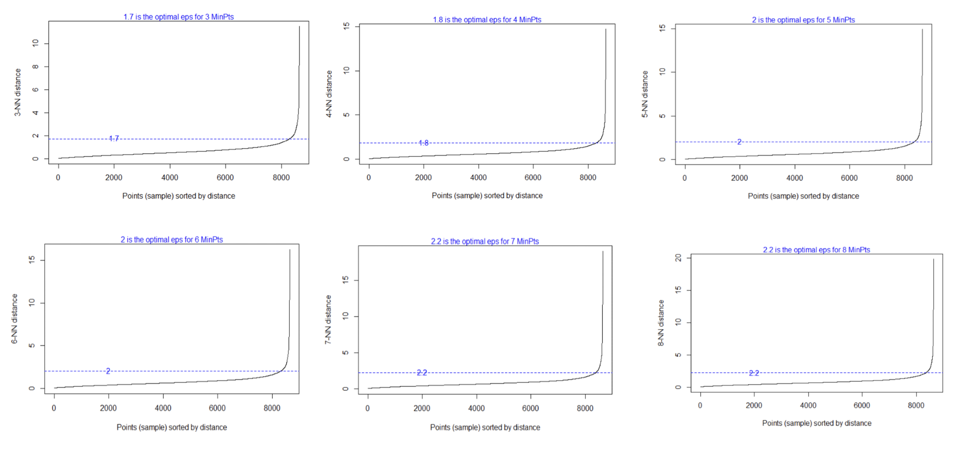
Visualizations

Slide 25
DBSCAN Cluster Analysis
Impact of Minimum Points (MinPts )
Inappropriate for Dataset
Notes:
Analysis:
Impact of Minimum Points(MinPts): Experimenting with different MinPts values shows how it affects the clustering results.
Suitability for Dataset: Observations suggest that DBSCAN may not be suitable for this dataset due to densely packed data points, leading to challenges in identifying distinct clusters.

Slide 26
Conclusion
Model-Based Clustering (VEV Model):
Cluster Detection
Distinct Characteristics
Cluster Analysis:
It comprises of 5 Clusters
Comparative Analysis:
VEV Model
CLARA
HKmeans and Fuzzy Clustering
Notes:
Conclusion:
Model-Based Clustering (VEV Model):
Cluster Detection: The VEV model successfully identifies 5 clusters, which is the highest number among all methods used in the analysis.
Distinct Characteristics: Each cluster demonstrates unique patterns of credit card usage, offering valuable insights into customer behavior.
Cluster Analysis:
Cluster 1: Less Active Users Preferring Cash-in-Advance
Cluster 2: Less Active Users Preferring Credit Card Purchases, Especially Installments
Cluster 3: Revolvers Preferring Expensive Purchases
Cluster 4: Less Active Users Preferring Full Repayment
Cluster 5: Active Users Making Expensive Purchases, Repaying in Big Amounts
Cluster 6: Max Payers Preferring Full Payment with Zero Tenure
Cluster 7: Less Active Revolvers, Spending Small Amounts on Cheaper Products
Cluster 8: Max Payers More Active in Purchases than Cluster 6
Comparative Analysis:
VEV Model: Identifies 5 clusters, providing detailed segmentation insights.
CLARA: Offers a balanced view with 5 distinct user groups.
HKmeans and Fuzzy Clustering: Provide a simpler segmentation with 2 groups.
Summary:
For Detailed Segmentation: The VEV model offers the most effective solution.
For Balanced Insights: CLARA provides a good balance between granularity and simplicity with 5 groups.
For Simplicity: HKmeans and Fuzzy clustering offer a simpler view with 2 groups.

Slide 27
References
Arjun Bhasin 2018, Credit card Dataset for Clustering, viewed 10 May 2022, https://www.kaggle.com/datasets/arjunbhasin2013/ccdata
Alboukadel Kassambara 2017, Practical Guide to Cluster Analysis in R, Multivariate Analysis 1, Edition 1, sthda.com
Clustering and dimensionality reduction techniques on the Berlin Airbnb data and the problem of mixed data (n.d.),viewed 15 May 2022 https://rstudio-pubs-static.s3.amazonaws.com/579984_6b9efbf84ee24f00985c29e24265d2ba.html
Jenny Listman 2019, Customer Segmentation / K Means Clustering, viewed 14 May 2022, https://www.kaggle.com/code/jennylistman/customer-segmentation-k-means-clustering
Matt.0 2019, 10 Tips for Choosing the Optimal Number of Clusters, viewed 12 May 2022, https://towardsdatascience.com/10-tips-for-choosing-the-optimal-number-of-clusters-277e93d72d92

Slide 28

Thank you

